Slide 1

Telecom Signal Stream Data Forge

Slide 2
Team Members
Ijaz Ahmad S
Kavya Bhatta S
Rakesh Kumar
Sahana J Upadhyaya

Slide 3
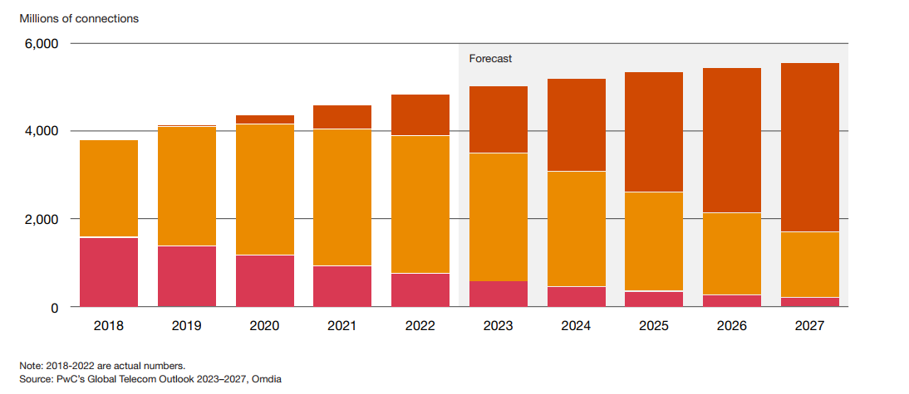
Problem Statement
Telecom companies generate huge volumes of mobile-signal data every day.
Delayed or manual analysis slows down issue detection and response.
Need a real-time solution to monitor and analyse network health instantly.
Objective
Build a real-time analytics pipeline using AWS Kinesis, Glue, Athena, and CloudWatch.
Enable continuous tracking of key metrics like signal strength, GPS precision, and network status.
Use Case
Simulate mobile log data (CSV) as live stream via Kinesis.
Perform ETL and cleaning using AWS Glue.
Store curated data in S3 and query insights with Athena.
Key Metrics:
Avg. Signal Strength per Region
GPS Accuracy per Postal Area and Operator
Network activity (Still, Tilting, Unknown, On_Foot, In_Vehicle)
Notes:
Problem Statement
Telecom companies receive millions of mobile signal and network logs every day — showing how users experience their network in different locations. However, analyzing this huge volume of data in real time is difficult. By the time reports are generated manually, network issues and outages are already affecting customers.
Our challenge was to build a system that can process and analyze this data live, so that network performance problems can be detected and resolved faster.
Use Case (Business Perspective)
Imagine a telecom operator wants to monitor signal quality across different cities in real time. Our pipeline takes mobile network logs (like signal strength, GPS accuracy, and connection status) and processes them instantly using AWS services.
The data is first streamed live from a simulated mobile log feed (as if coming from real users).
It is then processed and cleaned automatically using AWS Glue (ETL engine).
The results are stored and made ready for analysis in AWS Athena, where reports can show metrics such as:
Average signal strength by postal code
Network status distribution (Good, Moderate, Poor)
GPS accuracy by provider or region
This helps the company see where the network is weak or unstable almost immediately — allowing faster decision-making and better customer experience.

Slide 4
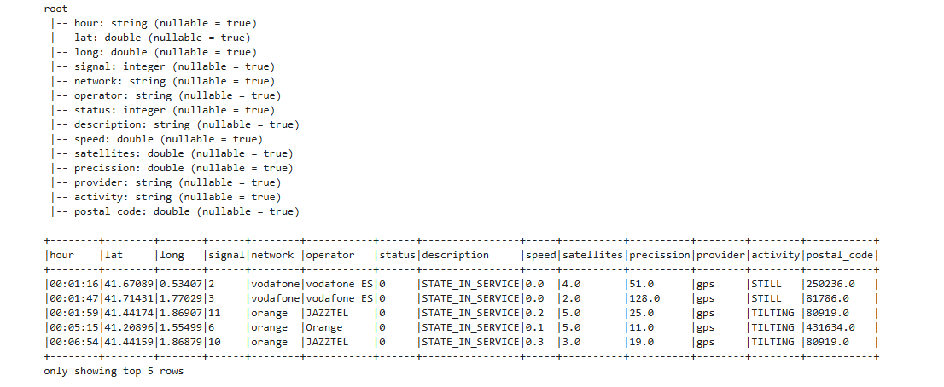
Input Data Overview
Schema & Sample
Dataset : mobile_logs
Format – csv
Streaming Data

Slide 5
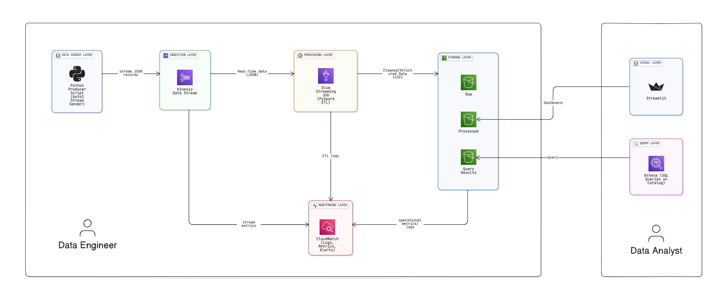
High-Level Architecture
Notes:
Purpose
To build a real-time data ingestion and processing pipeline using AWS services for mobile log data — ensuring scalability, automation, and analytical insights.
Architecture Overview
This pipeline automates the flow of data from a CSV dataset to real-time analytics through five major layers:
Data Source Layer
The raw dataset (Mobile Logs CSV) acts as the data source.
A Python Producer Script (using boto3) reads the dataset and sends records as JSON streams.
This simulates live log events being pushed into AWS.
Ingestion Layer
Amazon Kinesis Data Stream receives and buffers streaming data in real time.
It can handle high-throughput streams and ensure message durability.
Data is then forwarded for ETL processing.
Processing Layer
AWS Glue Streaming Job (PySpark ETL) processes incoming JSON data continuously.
Cleans and transforms records.
Applies schema mapping and filtering.
AWS Glue Crawler automatically updates the Data Catalog, ensuring schemas are inferred dynamically.
Output: Cleaned & Structured CSV data.
Storage Layer
Amazon S3 acts as the central data lake.
raw/ → raw incoming data
processed/ → transformed/cleaned data
query-results/ → Athena query outputs
Enables data versioning and future reprocessing.
Query Layer
Amazon Athena performs SQL-based analytics directly on S3 data (via the Glue Data Catalog).
Query results are stored back in S3 for further visualization or reporting.
Monitoring Layer
Amazon CloudWatch collects and visualizes:
Stream metrics (from Kinesis)
ETL job logs (from Glue)
Operational alerts (failures, latency, etc.)
Ensures continuous visibility and debugging support.
Key Benefits
Fully Serverless — no infrastructure management
Real-time streaming and transformation
Schema automation via Glue Crawler
Pay-per-query analytics with Athena
End-to-end monitoring with CloudWatch

Slide 6
Tools & Services Used:
Service | Purpose
Amazon S3 | Central data lake (stores raw, processed, scripts, checkpoints, and query outputs).
Amazon Kinesis Data Stream | Real-time ingestion of mobile log data (acts as the streaming data source).
AWS Glue | Performs ETL processing (Spark Streaming job reads from Kinesis, writes to S3 in Parquet).
AWS IAM | Provides roles and permissions for Glue, Kinesis, and S3 access control.
Amazon Athena | Serverless query engine to analyze processed data stored in S3 using SQL.
Amazon CloudWatch | Monitors Glue job execution and logs for troubleshooting.

Slide 7
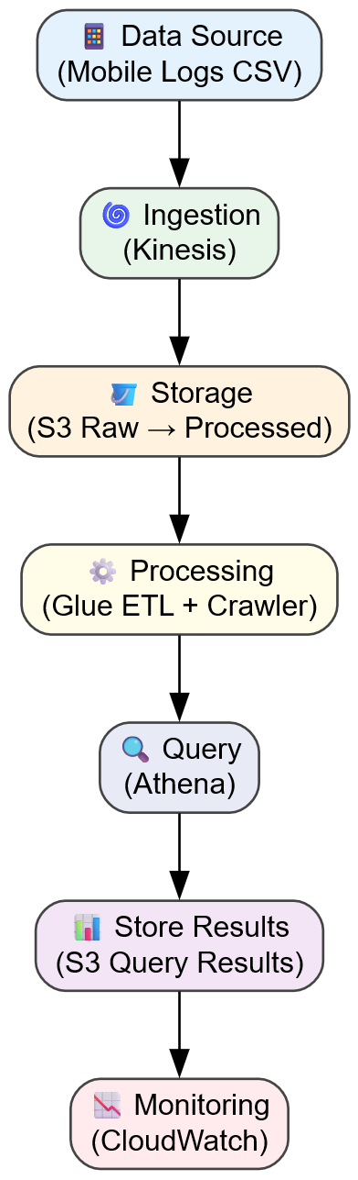
Detailed Pipeline Flow
Notes:
🗒️ Talking Notes:
1. Data Source (📱 Mobile Logs CSV)
The pipeline begins with a mobile logs dataset (CSV) that simulates real telecom network data — signal strength, GPS coordinates, and network status.
A Python producer script streams this data in real-time to AWS.
2. Ingestion Layer (🌀 Kinesis Data Stream)
Amazon Kinesis acts as the real-time ingestion point.
It receives streaming records continuously and ensures scalable, fault-tolerant data capture.
Helps handle high velocity and volume of telecom signal logs.
3. Storage Layer (🪣 S3 Raw → Processed)
Incoming data is first stored in S3 (Raw Zone) for reliability and traceability.
After transformation, it’s moved to S3 (Processed Zone) — organized and cleaned for analysis.
Acts as a central data lake.
4. Processing Layer (⚙️ Glue ETL + Crawler)
AWS Glue Streaming Job (PySpark) cleans and transforms raw JSON data into structured format.
A Glue Crawler updates the Data Catalog, automatically detecting schema and data types.
Key metrics like average signal strength and network status are computed here.
5. Query Layer (🔍 Athena)
Amazon Athena runs SQL queries directly on processed S3 data.
Enables analysts to get on-demand insights without complex setup.
Example queries: “Average signal per region”, “GPS accuracy by postal code”.
6. Result Storage (📊 S3 Query Results)
Query results are stored back in S3 for easy visualization and reuse.
Can be connected to QuickSight or dashboards for reporting.
7. Monitoring Layer (📉 CloudWatch)
AWS CloudWatch tracks ETL job metrics, Kinesis stream health, and system alerts.
Ensures pipeline reliability and early detection of data flow issues. This section demonstrates how we implemented each AWS component step-by-step — from streaming data to generating analytical insights.

Slide 8
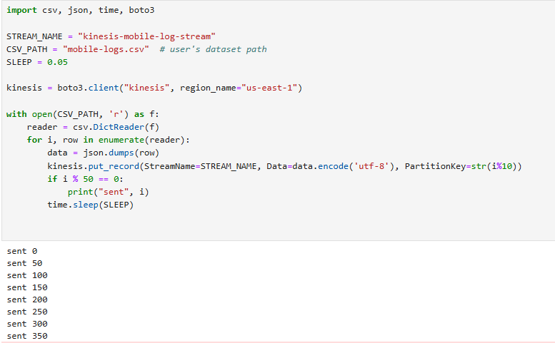
Data Ingestion
Python Data Ingestion Script
Simulates real-time telecom data from CSV.
Converts each row to JSON and sends it to Kinesis Data Stream.
Handles retries and batching for performance.
Notes:
This Python script is designed to simulate streaming data from a local CSV file into an Amazon Kinesis Data Stream. It processes the CSV data, converts each row into a JSON object, and then sends it as a record to the Kinesis stream.
Here is a breakdown of the script's components and actions:
💻 Dependencies and Setup
import csv, json, time, boto3: Imports necessary Python modules:
csv: To read and process the CSV file.
json: To convert the CSV row (dictionary) into a JSON string for the Kinesis record.
time: To introduce a delay between sending records (simulating a stream).
boto3: The Amazon Web Services (AWS) SDK for Python, used to interact with Kinesis.
Constants:
STREAM_NAME = "kinesis-mobile-log-stream": Specifies the name of the target Kinesis Data Stream.
CSV_PATH = "mobile-logs.csv": Specifies the path to the local data file.
SLEEP = 0.05: Defines the pause (in seconds) between sending each record.
Kinesis Client Initialization:
kinesis = boto3.client("kinesis", region_name="us-east-1"): Creates a client object to interact with the Kinesis service, specifically in the us-east-1 region.
🚀 Data Processing and Streaming Logic
The core of the script is the loop that reads the file and sends data:
Open and Read CSV:
Python
with open(CSV_PATH, 'r') as f:
reader = csv.DictReader(f)
Opens the file at CSV_PATH for reading.
csv.DictReader(f) treats each row in the CSV as a dictionary where the keys are the column headers.
Iterate and Send Records:
Python
for i, row in enumerate(reader):
data = json.dumps(row)
kinesis.put_record(StreamName=STREAM_NAME, Data=data.encode('utf-8'), PartitionKey=str(i%10))
# ... (logging and sleep)
for i, row in enumerate(reader):: Loops through each row (row is a dictionary) and keeps track of the record index (i).
data = json.dumps(row): Converts the dictionary (row) into a JSON formatted string. Kinesis records typically contain JSON or similar serialized data.
kinesis.put_record(...): This is the crucial AWS SDK call that sends the data:
StreamName=STREAM_NAME: Targets the specified Kinesis stream.
Data=data.encode('utf-8'): The JSON string is encoded into bytes (UTF-8) before being sent, as Kinesis expects a byte array.
PartitionKey=str(i%10): Assigns a Partition Key to the record. The modulo operation (i % 10) ensures that records are distributed across 10 different partition keys (e.g., "0", "1", "2", ..., "9"). The Partition Key is essential for Kinesis to determine which shard (a logical partition of the stream) the record will be written to, ensuring even data distribution.
Flow Control and Monitoring:
Python
if i % 50 == 0:
print("sent", i)
time.sleep(SLEEP)
Logging: Prints a status update every 50 records to show progress.
Delay: The time.sleep(0.05) ensures the records are sent at a slow, controlled rate, mimicking a steady stream of data rather than a bulk upload, which is a common pattern for data stream producers.
In essence, the script acts as a Producer sending records to the Kinesis Data Stream, which can then be processed by a Consumer application (not shown here).
Would you like to know more about Amazon Kinesis Data Streams or see an example of how the Partition Key affects record distribution?

Slide 9
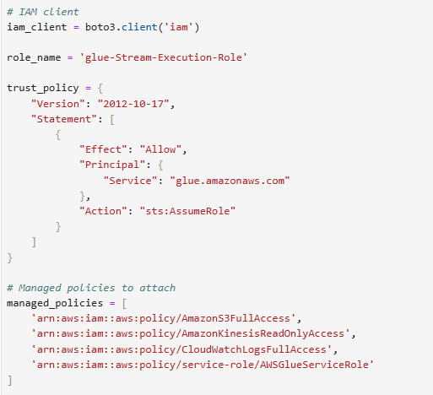
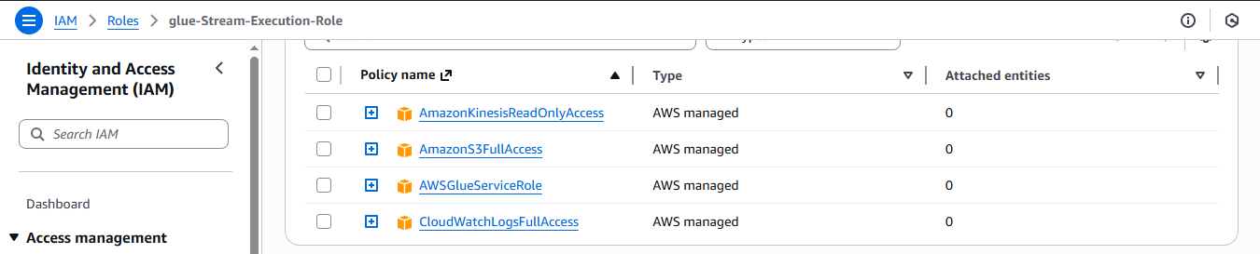
IAM Role Creation
Notes:
Required for Glue Jobs, Crawler, and Athena to access S3 & Kinesis securely.
The trust relationship allows Glue to assume the role. Highlight: “This ensures that every AWS service in the pipeline operates with least privilege access.”

Slide 10
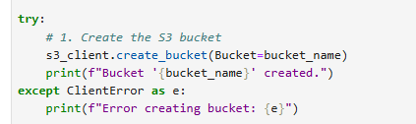
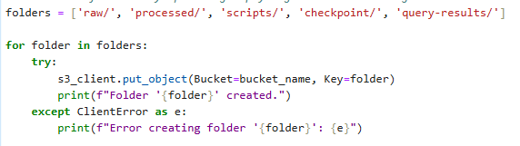
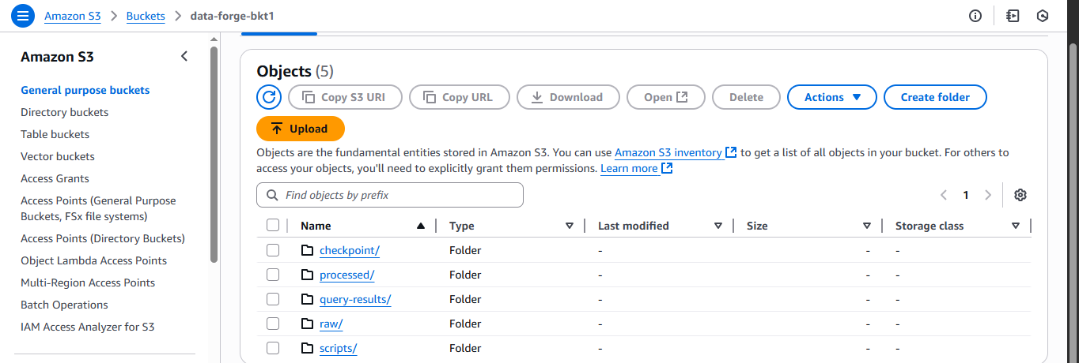
S3 Bucket Setup
data-forge-bkt1
Notes:
Required for Glue Jobs, Crawler, and Athena to access S3 & Kinesis securely.
The trust relationship allows Glue to assume the role. Highlight: “This ensures that every AWS service in the pipeline operates with least privilege access.”

Slide 11
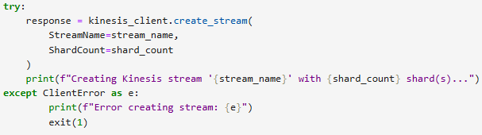
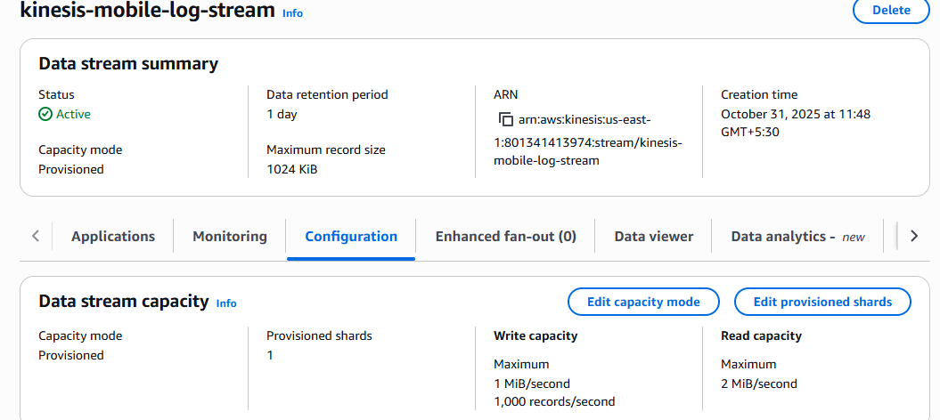
Kinesis Data Stream
Serverless Amazon Web Services (AWS) service for processing and analyzing real-time streaming data at scale.
Notes:
Required for Glue Jobs, Crawler, and Athena to access S3 & Kinesis securely.
The trust relationship allows Glue to assume the role. Highlight: “This ensures that every AWS service in the pipeline operates with least privilege access.”

Slide 12
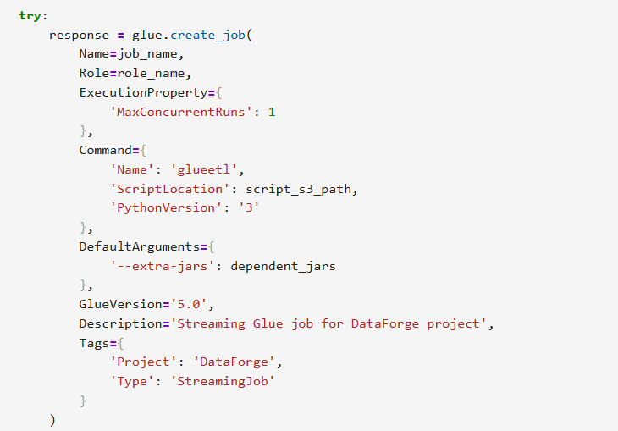
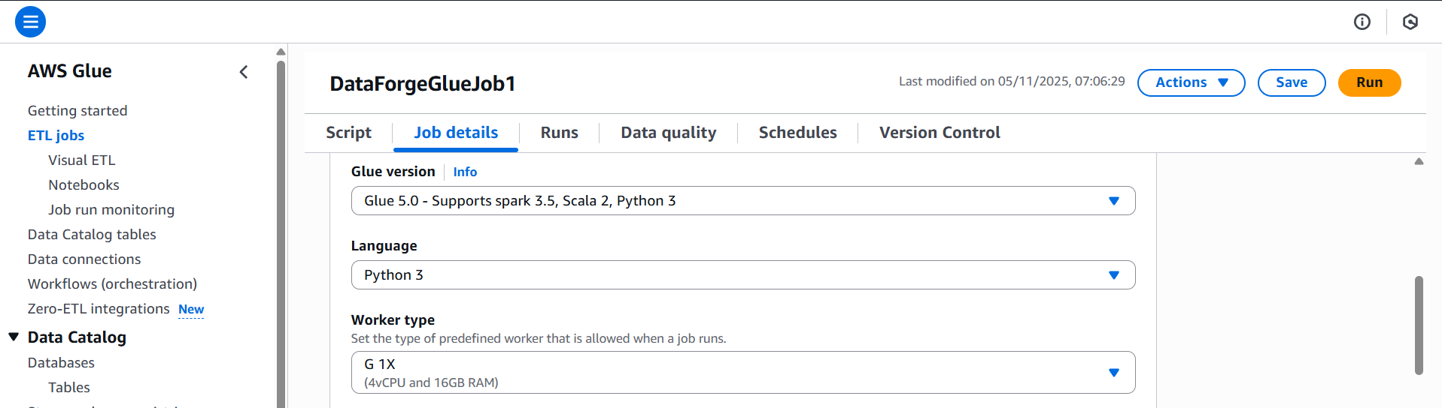
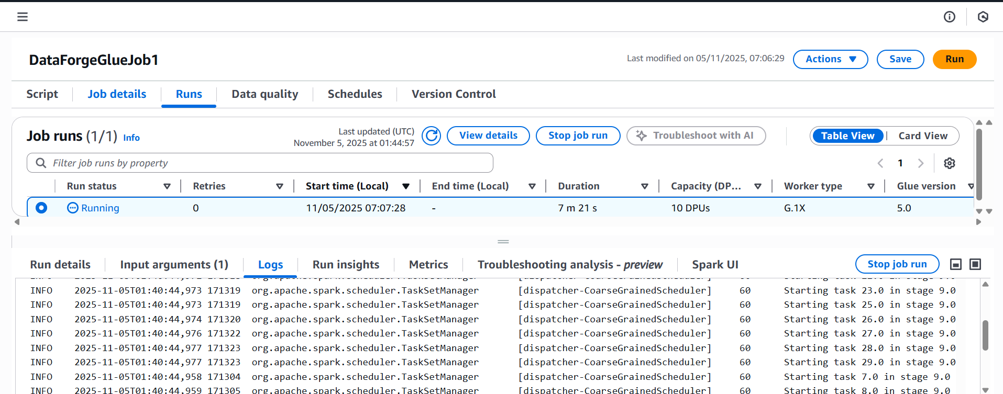
AWS Glue Streaming ETL Job
Serverless Amazon Web Services (AWS) service for processing and analyzing real-time streaming data at scale.
Name : kinesis-mobile-log-stream
Shard count = 1
Each shard supports ~1MB/sec data write and 2MB/sec read.
Notes:
Required for Glue Jobs, Crawler, and Athena to access S3 & Kinesis securely.
The trust relationship allows Glue to assume the role. Highlight: “This ensures that every AWS service in the pipeline operates with least privilege access.”

Slide 13
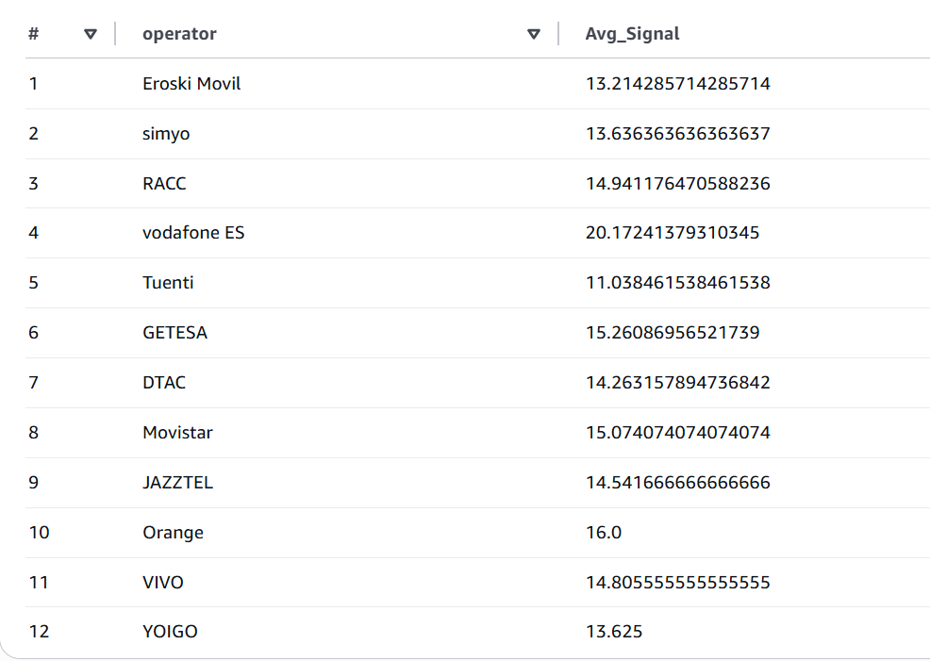
KPI’s
Notes:
Required for Glue Jobs, Crawler, and Athena to access S3 & Kinesis securely.
The trust relationship allows Glue to assume the role. Highlight: “This ensures that every AWS service in the pipeline operates with least privilege access.”

Slide 14
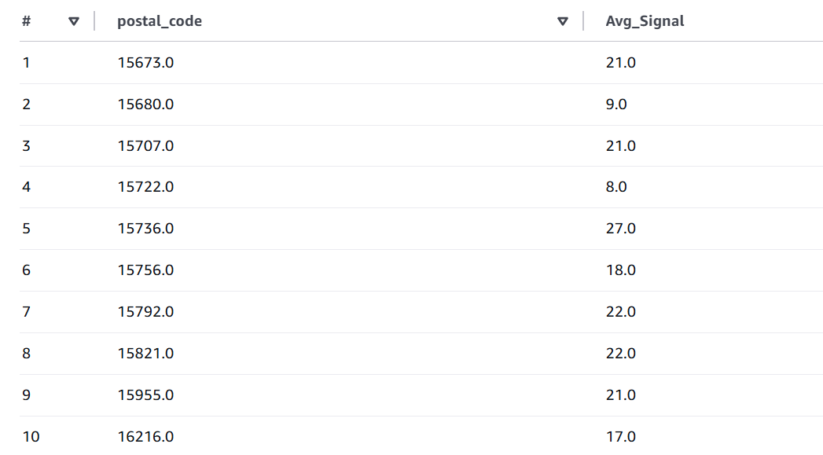
KPI’s
Notes:
Required for Glue Jobs, Crawler, and Athena to access S3 & Kinesis securely.
The trust relationship allows Glue to assume the role. Highlight: “This ensures that every AWS service in the pipeline operates with least privilege access.”

Slide 15
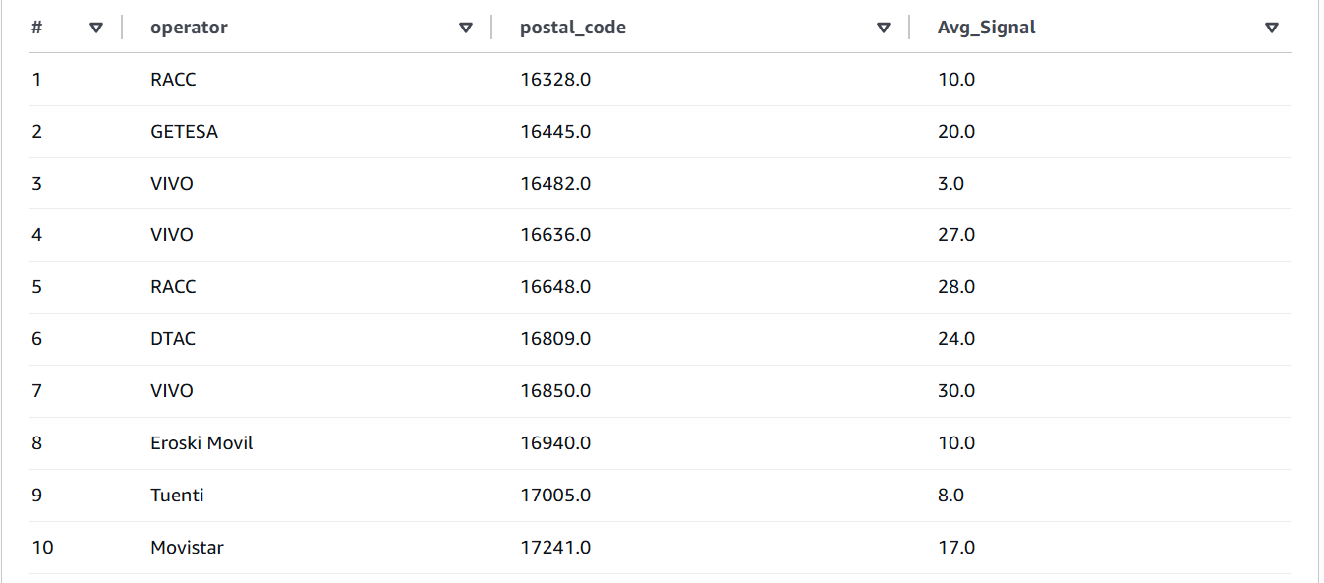
KPI’s
Notes:
Required for Glue Jobs, Crawler, and Athena to access S3 & Kinesis securely.
The trust relationship allows Glue to assume the role. Highlight: “This ensures that every AWS service in the pipeline operates with least privilege access.”

Slide 16
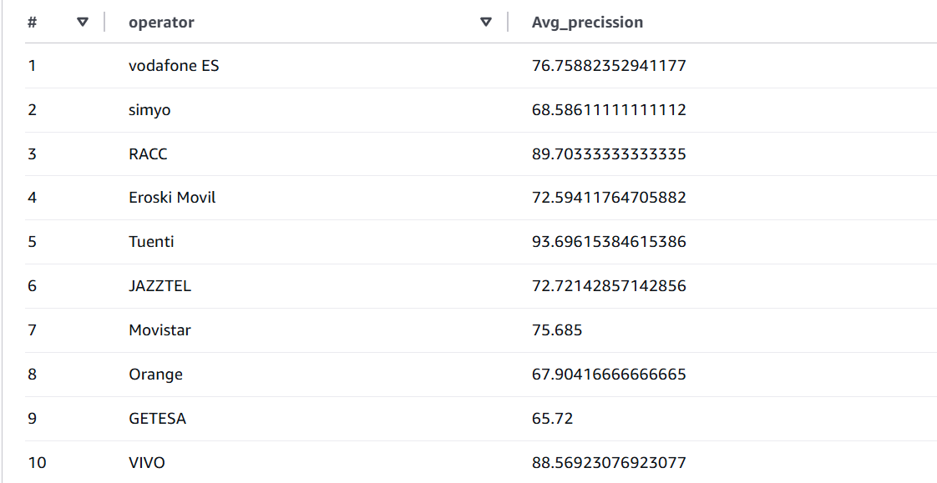
KPI’s
Notes:
Required for Glue Jobs, Crawler, and Athena to access S3 & Kinesis securely.
The trust relationship allows Glue to assume the role. Highlight: “This ensures that every AWS service in the pipeline operates with least privilege access.”

Slide 17
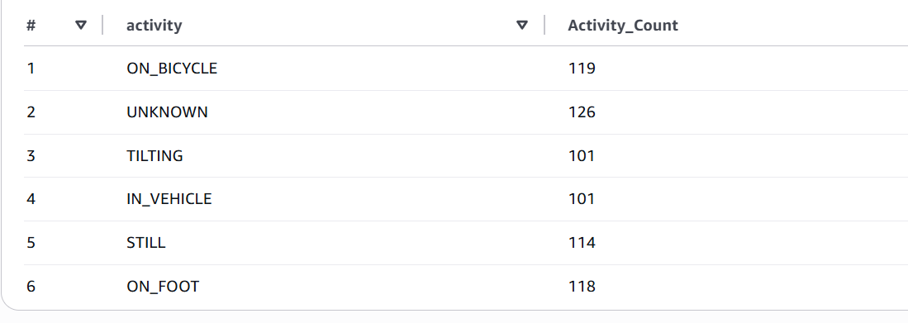
KPI’s
Notes:
Required for Glue Jobs, Crawler, and Athena to access S3 & Kinesis securely.
The trust relationship allows Glue to assume the role. Highlight: “This ensures that every AWS service in the pipeline operates with least privilege access.”

Slide 18
Business Output
Customer segmentation insights
Subscription conversion insights
Sales patterns & KPIs

Slide 19
Roles & Contributions
Clear ownership by each member
Version control / collaboration summary (GitHub /JIRA / references)

Slide 20
Key Learnings
1. AWS Data Pipeline : DesignLearned how to build a real-time data pipeline connecting Kinesis Data Stream → AWS Glue → S3 → Athena for end-to-end data processing.
Spark Structured StreamingGained hands-on experience with reading continuous streams using .readStream and writing results with .writeStream.
5. Schema Handling & Data TransformationPracticed defining JSON schemas, parsing dynamic data, and transforming raw data into structured CSV output.
8. Offline Testing & Local SimulationDeveloped a local test setup using Docker + Spark to simulate streaming with JSON files before deploying to AWS.
10. AWS Cloud IntegrationExplored Glue Catalog, Athena, and S3 as a seamless ecosystem for data storage, querying, and analytics.

Slide 21
Challenges
Kinesis Connector Missing (ClassNotFoundException)Added the correct Spark-SQL-Kinesis connector JAR using --extra-jars or session configuration.
Streaming vs Batch ConfusionRealized that writeStream works only for streaming DataFrames and used readStream correctly instead of from_catalog()
Base64 Encoding of Kinesis DataImplemented decoding logic and parsed JSON correctly using Spark functions like from_json.
Time Conversion & Null HandlingCorrected timestamp parsing (to_timestamp()) and used .na.drop() to clean invalid rows.

Slide 22
Final Takeaways
Developed a complete AWS streaming data pipeline using managed services.
Improved understanding of real-time ETL architecture and stream processing with Spark.
Gained deep hands-on experience with debugging, permissions, schema handling, and testing in both AWS and Docker.
Ready to scale this pipeline for larger, real-time data workloads.

Slide 23
Future Scope
Future Scope
Real-Time Analytics Dashboard Integrate with Amazon QuickSight or Grafana for live visualization of streaming data.
Data Quality & Validation Layer Add AWS Lambda or Glue triggers to validate and cleanse data before storage.
Scalable Multi-Stream Integration Extend the pipeline to handle multiple Kinesis streams for different data sources or applications.

Slide 24
Demo

Slide 25
Thank you

